Slide 1



Supply Chain Analysis in FMCG Domain
Presenter
Aryadevi R

Slide 2
Agenda
Introduction
Project Scope
Solution Approach
Analysis Outcomes
Primary goals

Slide 3
Introduction
AtliQ Mart is a growing FMCG manufacturer headquartered in Gujarat, India which is currently operating in Surat, Ahmedabad and Vadodara. They are planning to expand to other metros/Tier 1 cities in the next 2 years
3

Slide 4


Primary goals
Track ‘On Time’ & ‘In Full’ delivery service level for all customers daily basis.
Measure ‘On-time delivery (OT)%’, ‘In-full delivery (IF)%’ & ‘On Time in full (OTIF)%’ of customer orders daily basis against the target service level.

Slide 5
Project Scope
Dashboard should depict both low and high level insights
Clean and model data for analysis
Identify data source
Create a dashboard that measures KPIs
Provide relevant filters

Slide 6




Solution Approach
5 tables
3 dimension tables – customers, products, date, target orders 2 fact tables – order_lines, order aggregates
Visualization/ Dashboard
Data imported, analysed and transformed
Relationships between tables

Slide 7
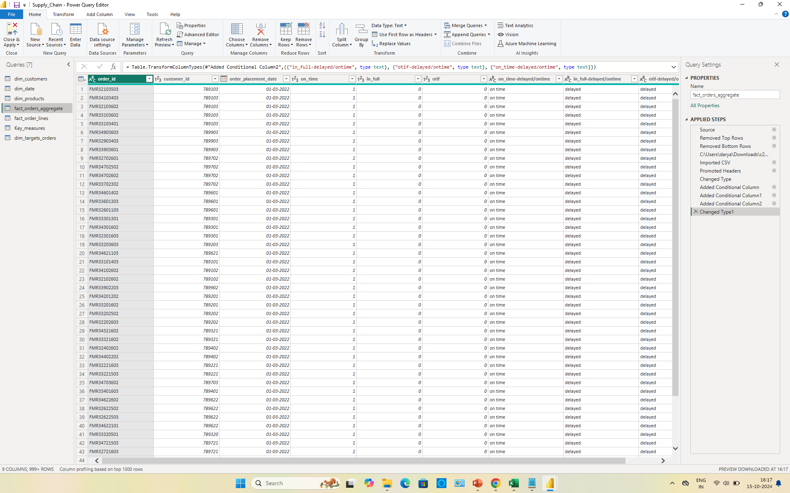
Data Cleaning/Transformation in Power Query

Slide 8
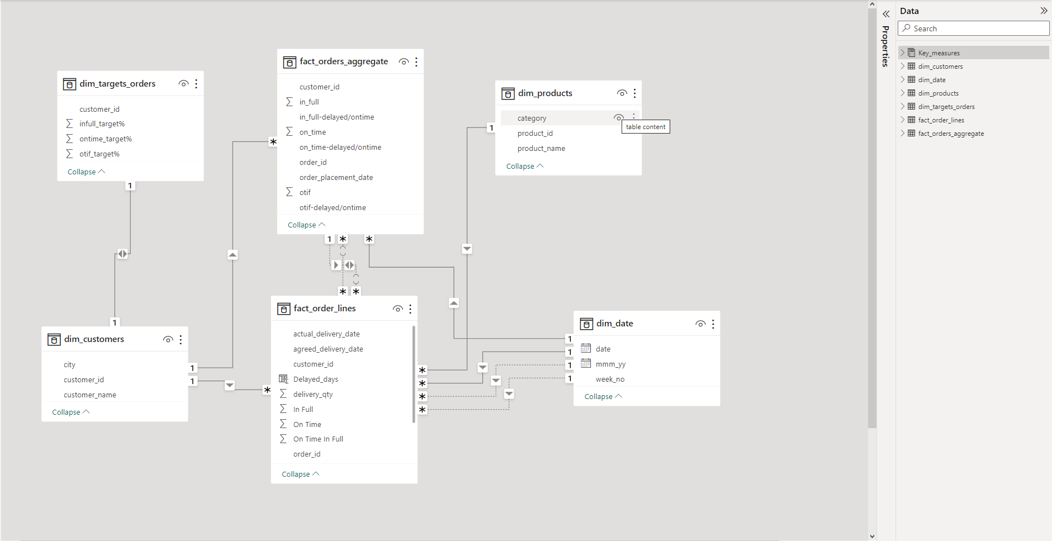
Data Modelling in Power Pivot

Slide 9
Solution Approach
Total order lines
Line fill rate (LIFR%)
Volume fill rate (VOFR%)
Total orders
On time delivery (OT%)
Count of all order lines from fact_order_lines table
Number of order lines shipped In Full Quantity / Total order lines
Total quantity shaped / total quantity ordered
Count of all orders from fact_orders_aggregate
Number of orders delivered On Time / Total number of orders

Slide 10
Solution Approach
In Full Delivery (IF%)
On Time In Full (OTIF%)
On Time Target
In Full Target
On Time In Full Target
Number of orders delivered In Full Quantity / Total number of orders
Number of orders delivered both In Full & On Time / Total number of orders
Average of On-Time Target from dim_targets_order
Average of In-Full Target from dim_targets_orders
Average of OTIF Target from dim_targets_orders

Slide 11
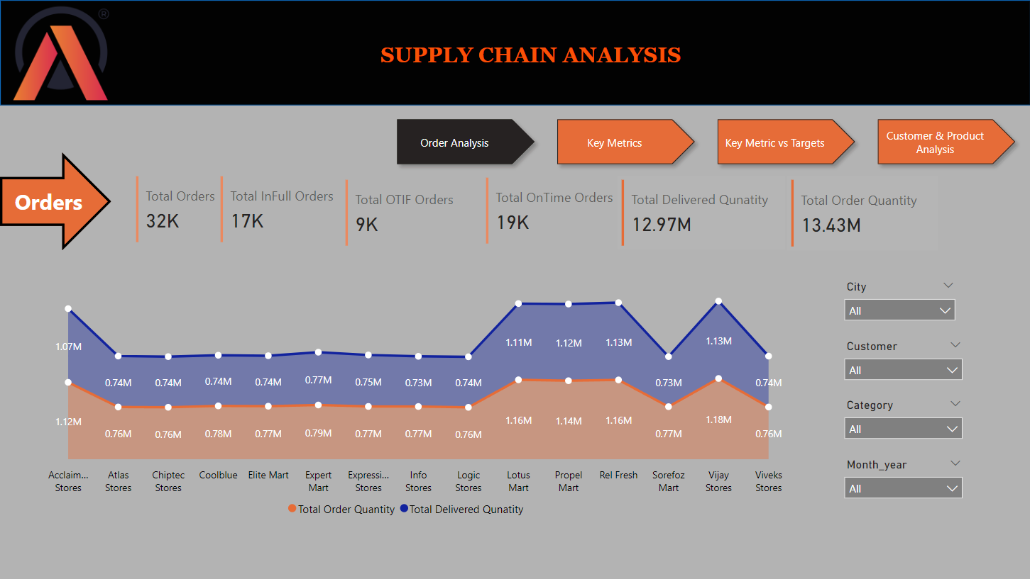
Order Analysis Dashboard
Bunch of cards
Stacked area chart plotted for customers with Total Order & Total Delivered quantity
Filters

Slide 12
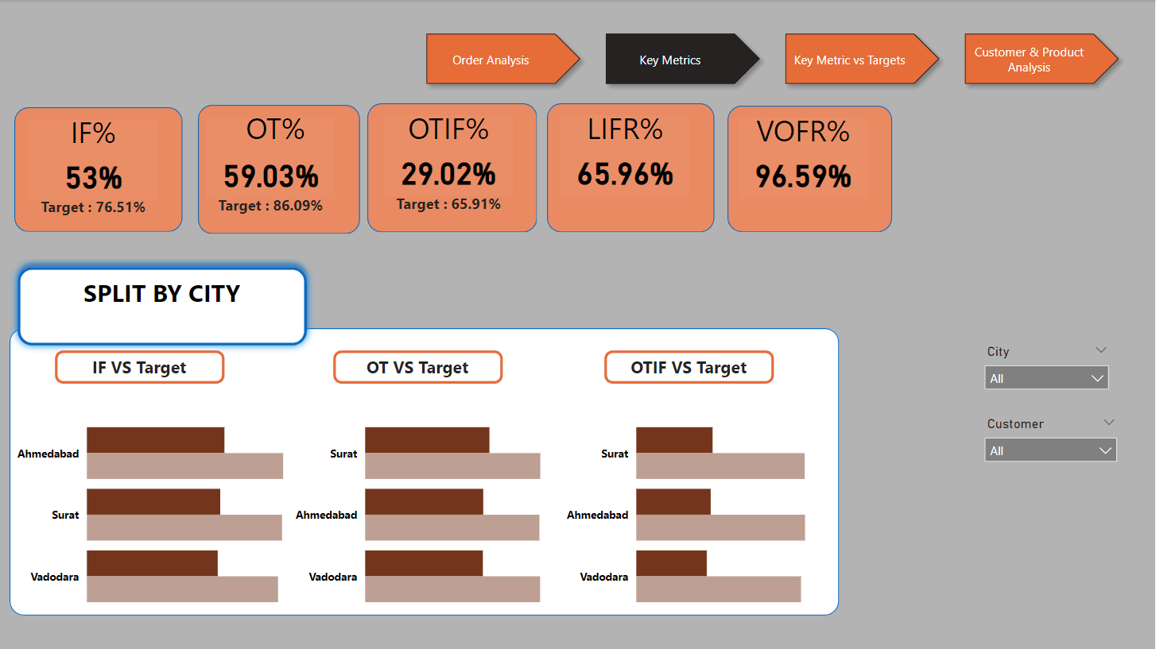
Order Analysis Dashboard
Bunch of cards
Stacked bar chart plotted for city for customer order levels and %
Filters

Slide 13
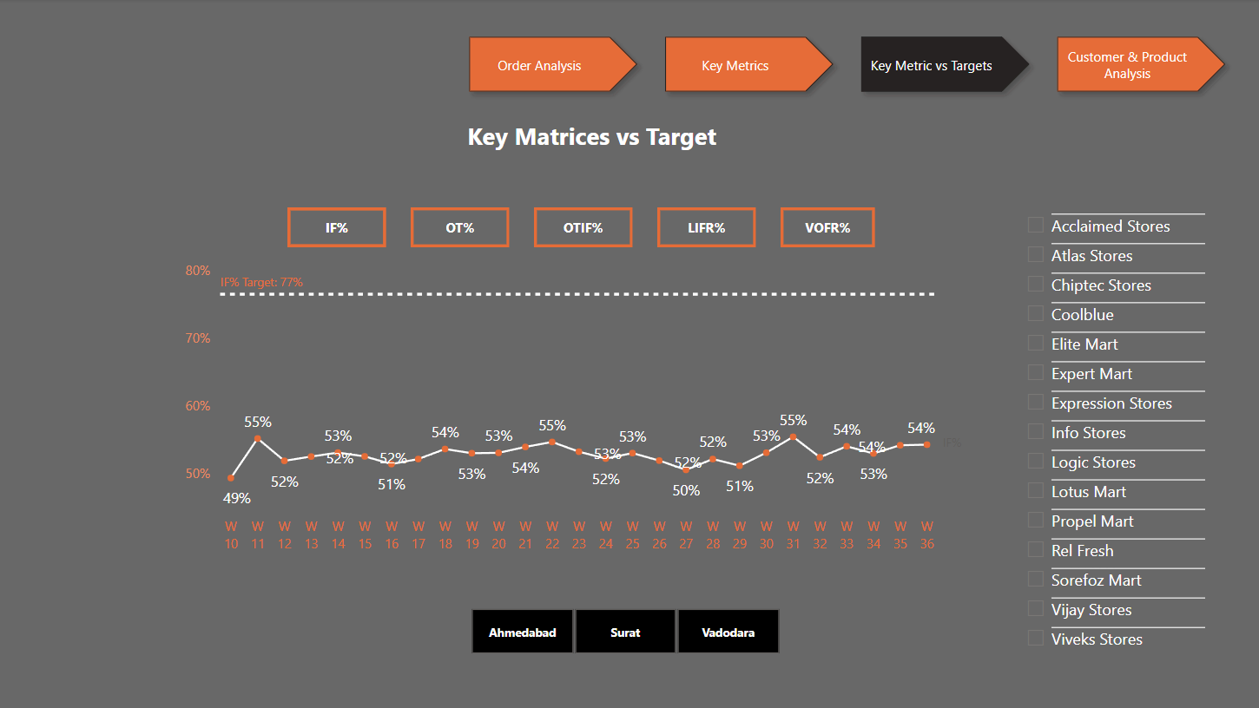
Order Analysis Dashboard
Line graph for customer service levels against target level
Filters

Slide 14
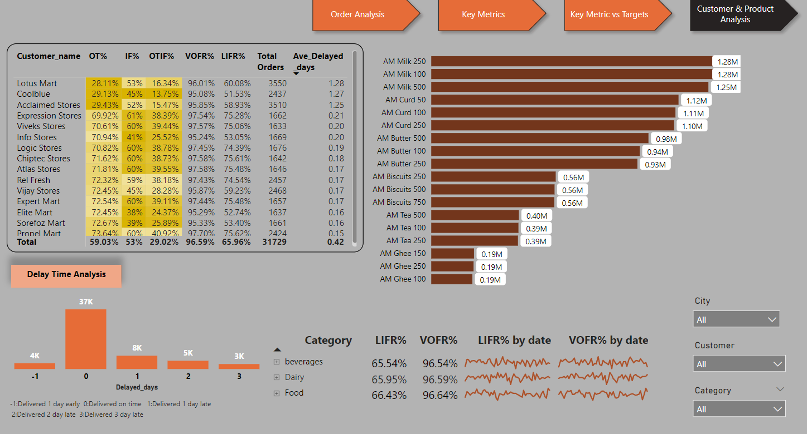
Order Analysis Dashboard
Bar graph for products and order quantity
Customer table with service levels
Matrix table with products & order service levels
Bar graph for delayed days for order lines
Filters

Slide 15



Analysis Outcomes
Full Order Quantity Not Delivered
Top 3 customers affected: Vijay Stores, Relfresh, Lotus Mart
Major Issue Areas
Delivery of dairy and food products
Performance Metrics
IF%, OT%, OTIF% targets not met any day
Average order delay: 0.42 days
15

Slide 16
Areas of focus
Ensure Product Availability
Identify Product Shortages
Analyze Availability & Shortages
Focus on Full Delivery
Customer Communication
Regular monitoring of inventory levels to ensure products are in stock
Implement effective stock replenishment strategies
Thorough check during logistics to identify missing items
Use tracking system to maintain accurate stock records
Collect & analyze data on product availability
Generate reports highlighting trends and root causes of shortages
Delivery team prioritizes ensuring customers receive complete orders
Clear communication with other departments for synchronized efforts
Promptly inform customers of any product shortages
Offer alternative solutions or adjusted delivery schedules
16

Slide 17




Thank you
Aryadevi R
aryadevi_r@outlook.com
Portfolio

